Slide 1
Chapter 4: Threads

Slide 2
Chapter 4: Threads
Overview
Multicore Programming
Multithreading Models
Thread Libraries
Implicit Threading
Threading Issues

Slide 3
Objectives
To introduce the notion of a thread—a fundamental unit of CPU utilization that forms the basis of multithreaded computer systems
To discuss the APIs for the Pthreads, Windows, and Java thread libraries
To explore several strategies that provide implicit threading
To examine issues related to multithreaded programming
To cover operating system support for threads in Windows and Linux

Slide 4
Multicore programming

Slide 5
Motivation
Most modern applications are multithreaded
Threads run within application
Multiple tasks with the application can be implemented by separate threads
Update display
Fetch data
Spell checking
Answer a network request
Process creation is heavy-weight while thread creation is light-weight
Can simplify code, increase efficiency
Kernels are generally multithreaded

Slide 6
Multithreaded Server Architecture

Slide 7
Benefits
Responsiveness – may allow continued execution if part of process is blocked, especially important for user interfaces
Resource Sharing – threads share resources of process, easier than shared memory or message passing
Economy – cheaper than process creation, thread switching lower overhead than context switching
Scalability – process can take advantage of multiprocessor architectures

Slide 8
Multicore Programming
Multicore or multiprocessor systems putting pressure on programmers, challenges include:
Dividing activities
Balance
Data splitting
Data dependency
Testing and debugging

Slide 9
Multicore Programming
Parallelism implies a system can perform more than one task simultaneously
Concurrency supports more than one task making progress
Single processor / core, scheduler providing concurrency
Types of parallelism
Data parallelism – distributes subsets of the same data across multiple cores, same operation on each
Task parallelism – distributing threads across cores, each thread performing unique operation
As # of threads grows, so does architectural support for threading
CPUs have cores as well as hardware threads
Consider Oracle SPARC T4 with 8 cores, and 8 hardware threads per core

Slide 10
Concurrency vs. Parallelism
Concurrent execution on single-core system:
Parallelism on a multi-core system:

Slide 11
Single and Multithreaded Processes

Slide 12
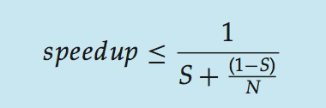
Amdahl’s Law
Identifies performance gains from adding additional cores to an application that has both serial and parallel components
S is serial portion
N processing cores

Slide 13
Amdahl’s Law
I.e. if application is 75% parallel / 25% serial, moving from 1 to 2 cores results in speedup of 1.6 times
As N approaches infinity, speedup approaches 1 / S
Serial portion of an application has disproportionate effect on performance gained by adding additional cores

Slide 14
Thread models

Slide 15
User Threads and Kernel Threads
User threads - management done by user-level threads library
Three primary thread libraries:
POSIX Pthreads
Win32 threads
Java threads
Kernel threads - Supported by the Kernel
Examples – virtually all general purpose operating systems, including:
Windows
Solaris
Linux
Tru64 UNIX
Mac OS X

Slide 16
Multithreading Models
Many-to-One
One-to-One
Many-to-Many

Slide 17
Many-to-One
Many user-level threads mapped to single kernel thread
One thread blocking causes all to block
Multiple threads may not run in parallel on muticore system because only one may be in kernel at a time
Few systems currently use this model
Examples:
Solaris Green Threads
GNU Portable Threads

Slide 18
One-to-One
Each user-level thread maps to kernel thread
Creating a user-level thread creates a kernel thread
More concurrency than many-to-one
Number of threads per process sometimes restricted due to overhead
Examples
Windows NT/XP/2000
Linux
Solaris 9 and later

Slide 19
Many-to-Many Model
Allows many user level threads to be mapped to many kernel threads
Allows the operating system to create a sufficient number of kernel threads
Solaris prior to version 9
Windows NT/2000 with the ThreadFiber package

Slide 20
Two-level Model
Similar to M:M, except that it allows a user thread to be bound to kernel thread
Examples
IRIX
HP-UX
Tru64 UNIX
Solaris 8 and earlier

Slide 21
Thread libraries

Slide 22
Thread Libraries
Thread library provides programmer with API for creating and managing threads
Two primary ways of implementing
Library entirely in user space
Kernel-level library supported by the OS

Slide 23
Pthreads
May be provided either as user-level or kernel-level
A POSIX standard (IEEE 1003.1c) API for thread creation and synchronization
Specification, not implementation
API specifies behavior of the thread library, implementation is up to development of the library
Common in UNIX operating systems (Solaris, Linux, Mac OS X)

Slide 24
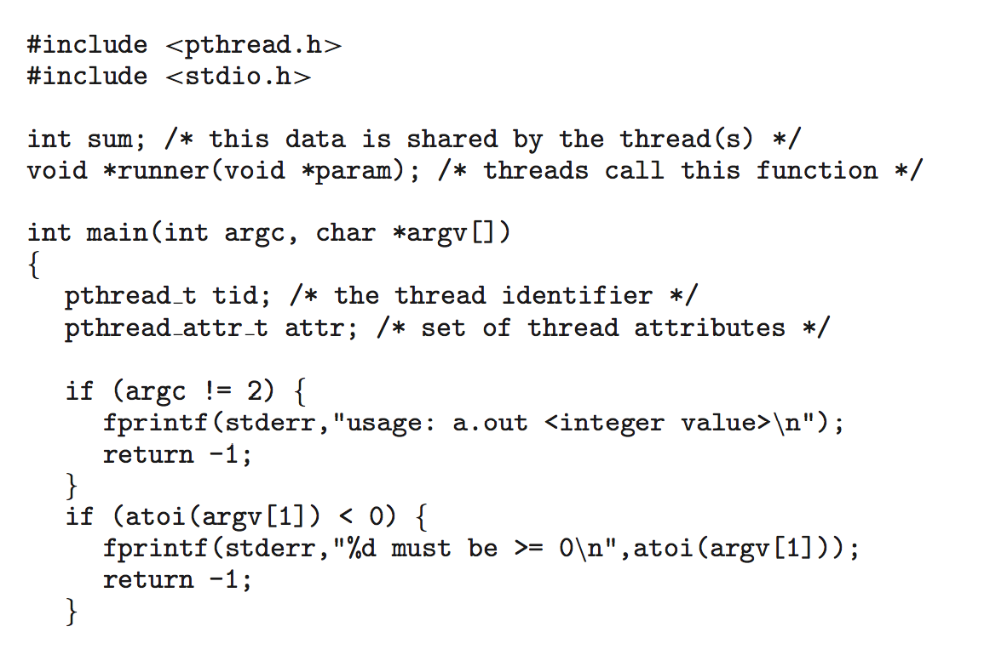
Pthreads Example

Slide 25
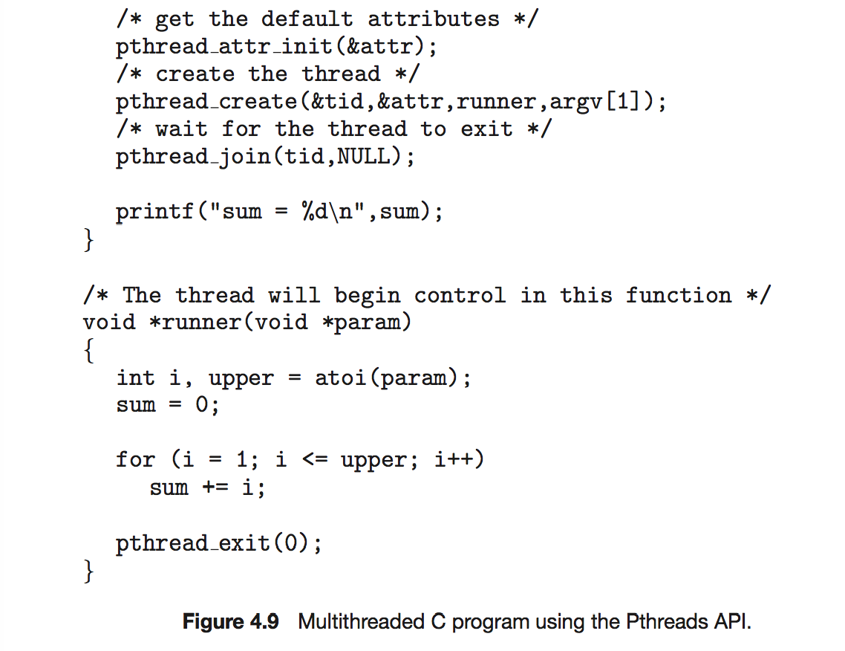
Pthreads Example (Cont.)

Slide 26
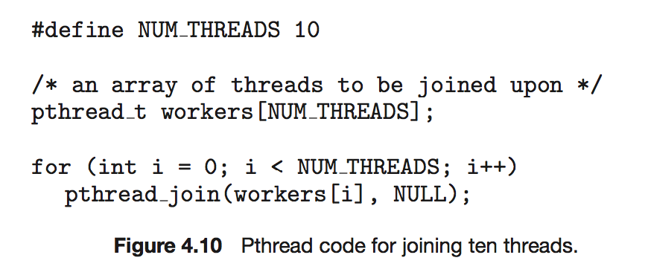
Pthreads Code for Joining 10 Threads

Slide 27
pthread_create and pthread_join
int pthread_create(tid, attr, function, arg)
int pthread_join(tid, val_ptr)

Slide 28
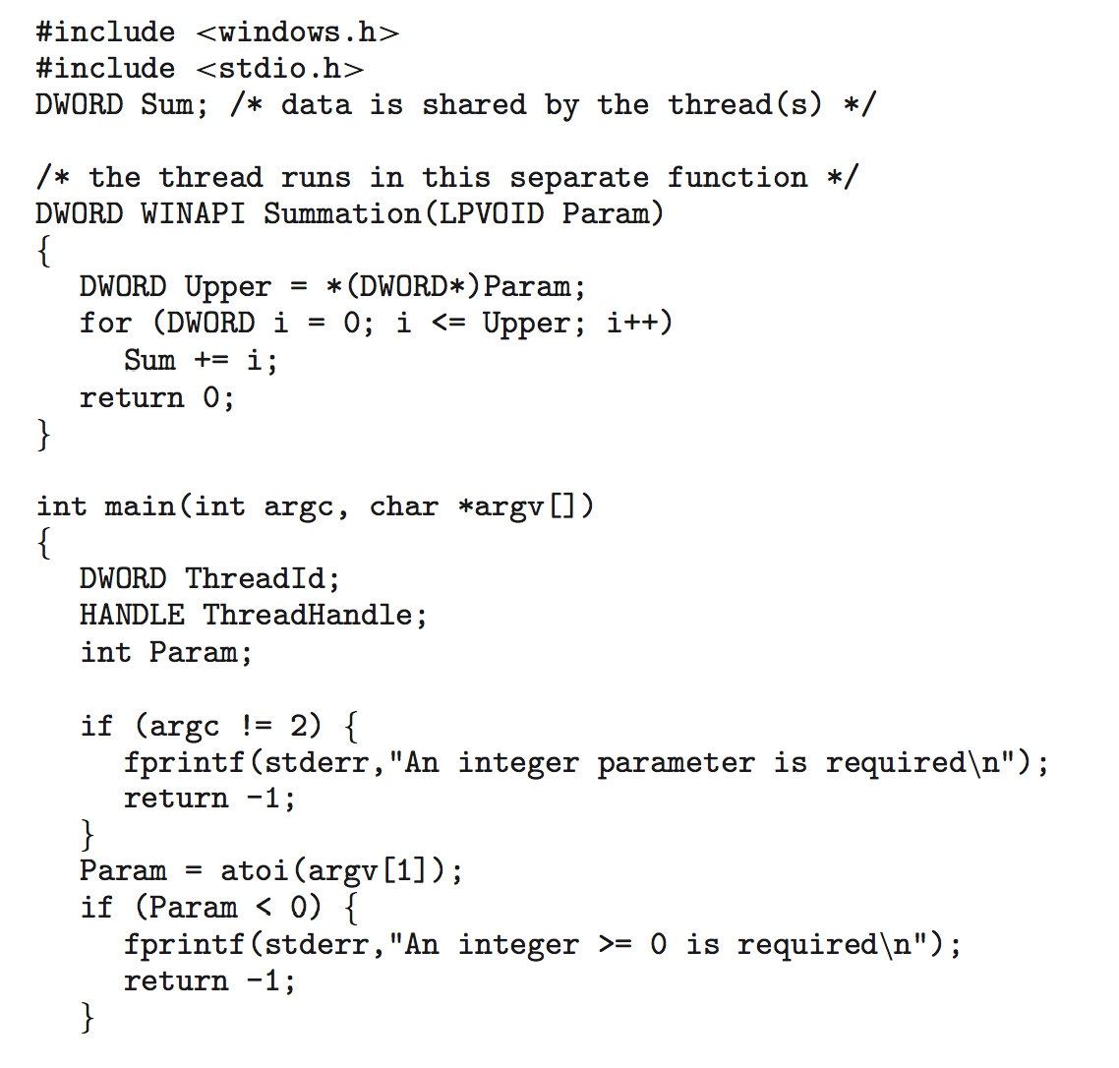
Win32 API Multithreaded C Program

Slide 29
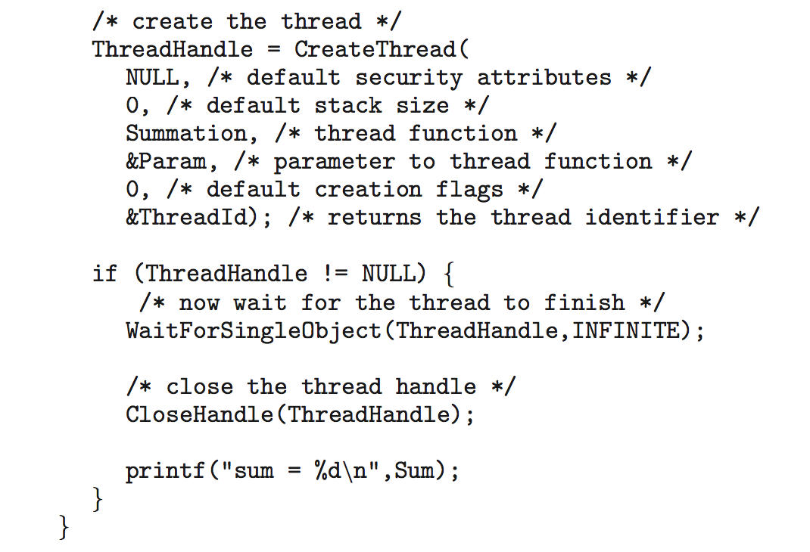
Win32 API Multithreaded C Program (Cont.)

Slide 30
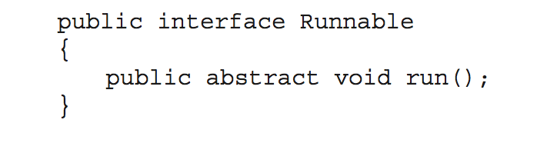
Java Threads
Java threads are managed by the JVM
Typically implemented using the threads model provided by underlying OS
Java threads may be created by:
Extending Thread class
Implementing the Runnable interface

Slide 31
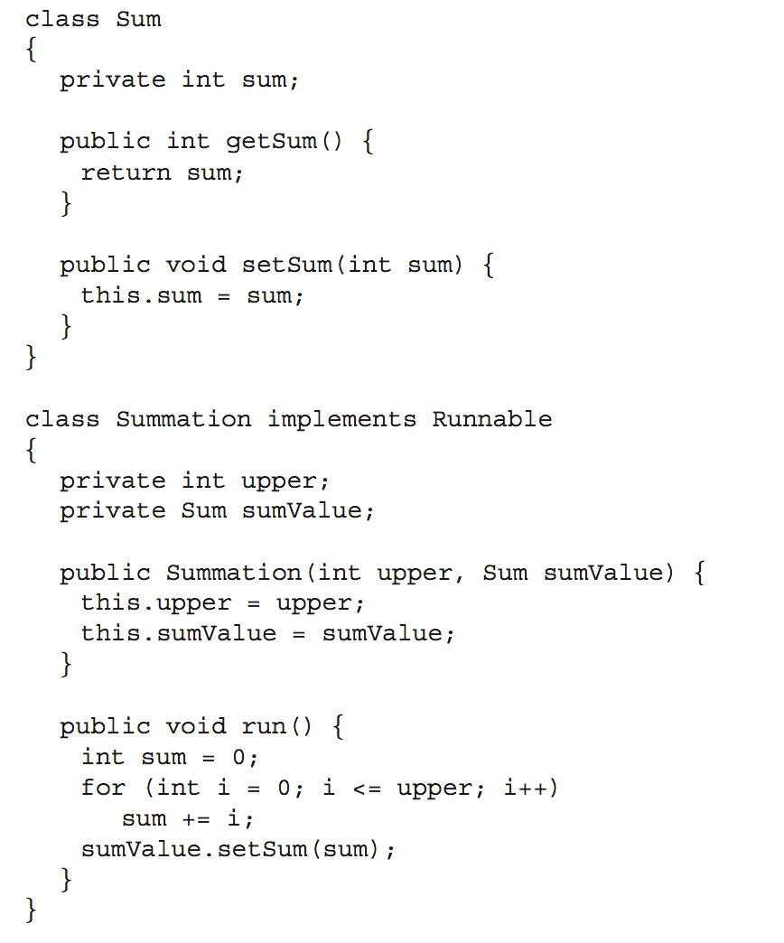
Java Multithreaded Program

Slide 32
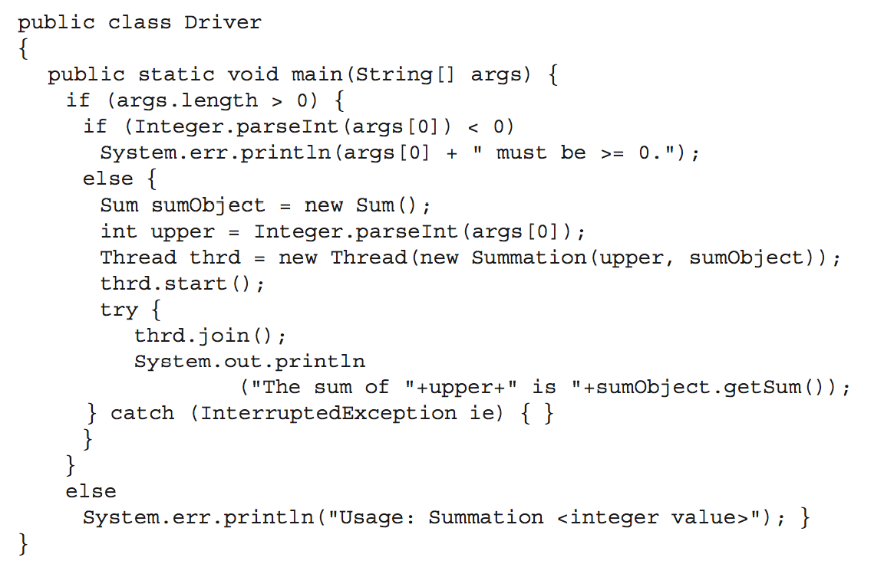
Java Multithreaded Program (Cont.)

Slide 33
Implicit threading

Slide 34
Implicit Threading
Growing in popularity as numbers of threads increase, program correctness more difficult with explicit threads
Creation and management of threads done by compilers and run-time libraries rather than programmers
Three methods explored
Thread Pools
OpenMP
Grand Central Dispatch
Other methods include Microsoft Threading Building Blocks (TBB), java.util.concurrent package

Slide 35
Thread Pools
Create a number of threads in a pool where they await work
Advantages:
Usually slightly faster to service a request with an existing thread than create a new thread
Allows the number of threads in the application(s) to be bound to the size of the pool
Separating task to be performed from mechanics of creating task allows different strategies for running task
i.e.Tasks could be scheduled to run periodically

Slide 36
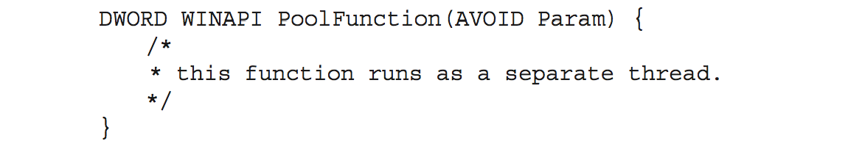
Windows API
Windows API supports thread pools:
QueueUserWorkItem(&function, param, flags);
QueueUserWorkItem(&PoolFunction, NULL, 0);

Slide 37
Java
Java API supports thread pools through Executor class
To separate thread management and creation from the rest of the application
newFixedThreadPool
newCachedThreadPool
newSingleThreadExecutor
Fork/Join pools in Java 7/8

Slide 38
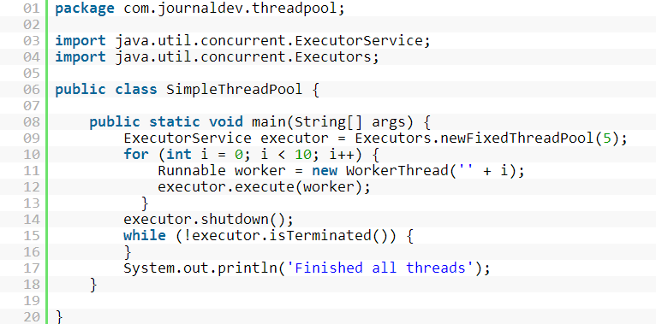
Java

Slide 39

OpenMP
Set of compiler directives and an API for C, C++, FORTRAN
Provides support for parallel programming in shared-memory environments
OpenMP is managed by the nonprofit technology consortium OpenMP Architecture Review Board (or OpenMP ARB)
including AMD, IBM, Intel, Cray, HP, Fujitsu, Nvidia, NEC, Microsoft, Texas Instruments, Oracle Corporation, and more
Identifies parallel regions – blocks of code that can run in parallel

Slide 40
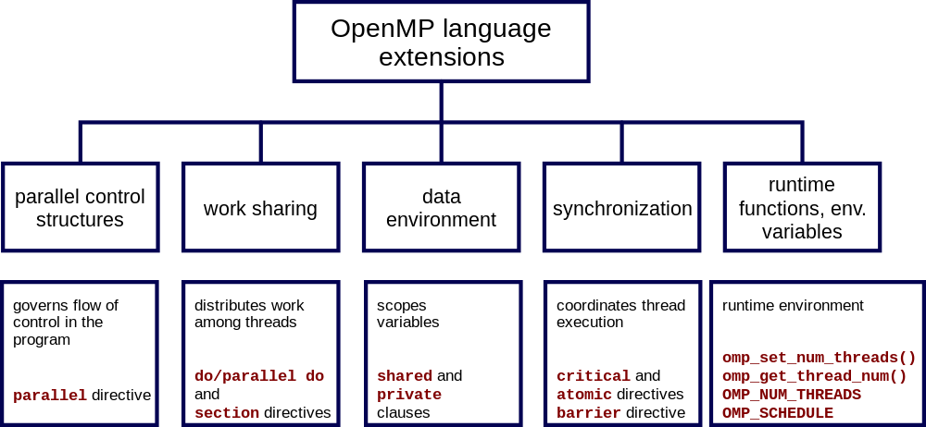
OpenMP

Slide 41
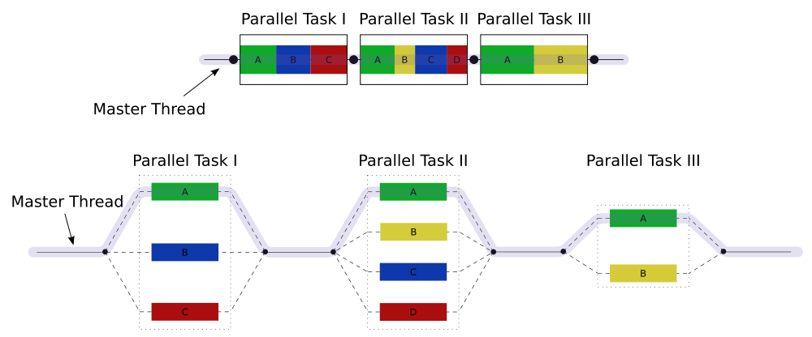
OpenMP
#pragma omp parallel //Create as many threads as there are cores
#pragma omp parallel for for(i=0;i<N;i++) {
c[i] = a[i] + b[i];
} //Run for loop in parallel

Slide 42

Grand Central Dispatch
Apple technology for Mac OS X and iOS operating systems
Extensions to C, C++ languages, API, and run-time library
Allows identification of parallel sections
Manages most of the details of threading
Block is in “^{ }” - ˆ{ printf("I am a block"); }
Blocks placed in dispatch queue
Assigned to available thread in thread pool when removed from queue

Slide 43
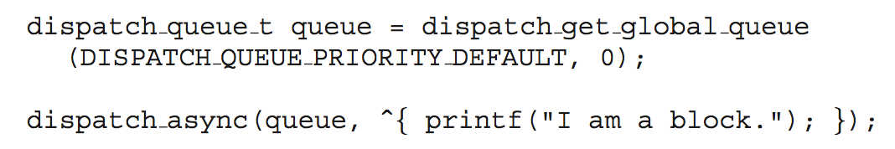
Grand Central Dispatch
Two types of dispatch queues:
serial – blocks removed in FIFO order, queue is per process, called main queue
Programmers can create additional serial queues within program
concurrent – removed in FIFO order but several may be removed at a time
Three system wide queues with priorities low, default, high
Open source, works in other OSes

Slide 44
Threading issues

Slide 45
Threading Issues
Semantics of fork() and exec() system calls
Signal handling
Synchronous and asynchronous
Thread cancellation of target thread
Asynchronous or deferred
Thread-local storage
Scheduler Activations

Slide 46
Semantics of fork() and exec()
Does fork()duplicate only the calling thread or all threads?
Some UNIXes have two versions of fork
Exec() usually works as normal – replace the running process including all threads

Slide 47
Linux Threads
Linux refers to them as tasks rather than threads
Thread creation is done through clone() system call
clone() allows a child task to share the address space of the parent task (process)
Flags control behavior
struct task_struct points to process data structures (shared or unique)

Slide 48
Signal Handling
Signals are used in UNIX systems to notify a process that a particular event has occurred.
A signal handler is used to process signals
Signal is generated by particular event – synchronous
Signal is delivered to a process – asynchronous
Signal is handled by one of two signal handlers:
default
user-defined

Slide 49
Signal Handling
Every signal has default handler that kernel runs when handling signal
User-defined signal handler can override default
For single-threaded, signal delivered to process
Where should a signal be delivered for multi-threaded?
Deliver the signal to the thread to which the signal applies
Deliver the signal to every thread in the process
Deliver the signal to certain threads in the process
Assign a specific thread to receive all signals for the process

Slide 50
Thread Cancellation
Terminating a thread before it has finished
Thread to be canceled is target thread
Two general approaches:
Asynchronous cancellation terminates the target thread immediately
Deferred cancellation allows the target thread to periodically check if it should be cancelled

Slide 51
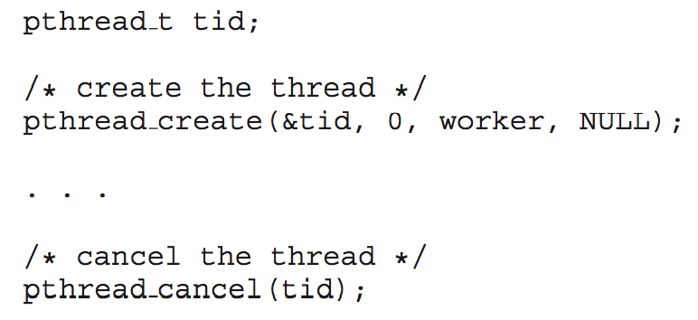
Thread Cancellation
Pthread code to create and cancel a thread:

Slide 52
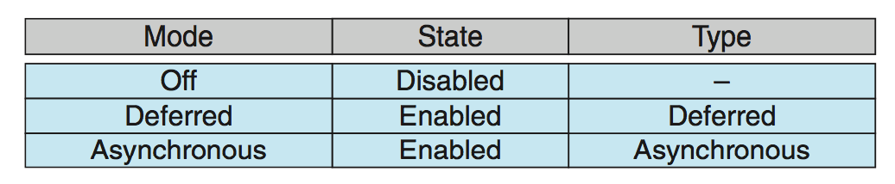
Thread Cancellation (Cont.)
Invoking thread cancellation requests cancellation, but actual cancellation depends on thread state
If thread has cancellation disabled, cancellation remains pending until thread enables it
Default type is deferred
Cancellation only occurs when thread reaches cancellation point
I.e. pthread_testcancel()
Then cleanup handler is invoked
On Linux systems, thread cancellation is handled through signals

Slide 53
Thread-Local Storage
Thread-local storage (TLS) allows each thread to have its own copy of data
Useful when you do not have control over the thread creation process (i.e., when using a thread pool)
Different from local variables
Local variables visible only during single function invocation
TLS visible across function invocations
Similar to static data
TLS is unique to each thread

Slide 54
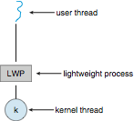
Scheduler Activations
Both M:M and Two-level models require communication to maintain the appropriate number of kernel threads allocated to the application
Typically use an intermediate data structure between user and kernel threads – lightweight process (LWP)
Appears to be a virtual processor on which process can schedule user thread to run
Each LWP attached to kernel thread
How many LWPs to create?

Slide 55
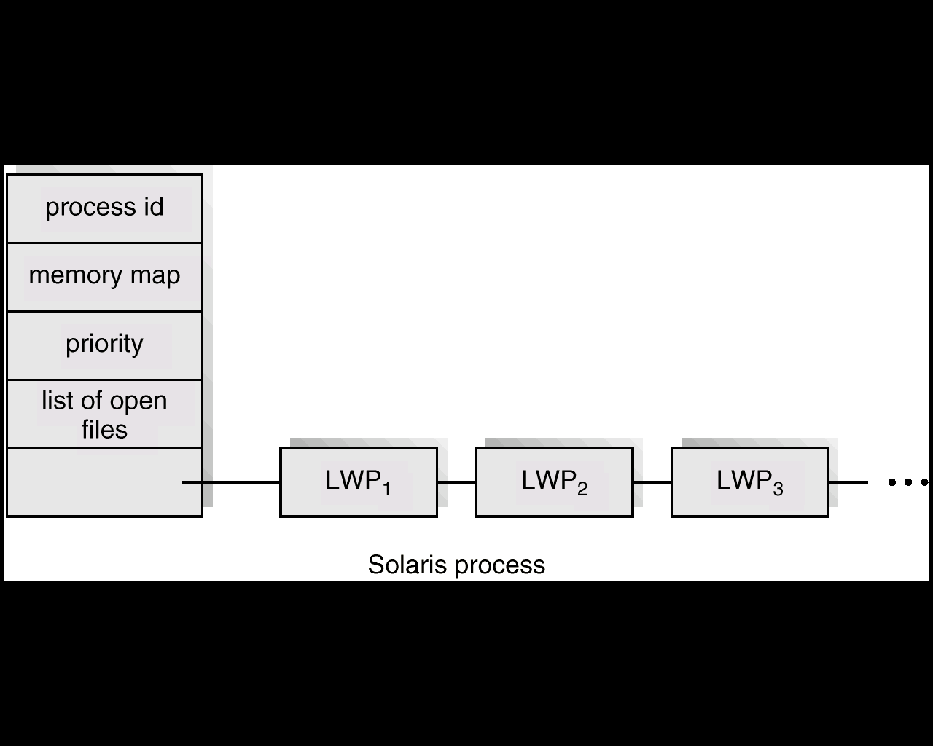
Solaris Process

Slide 56
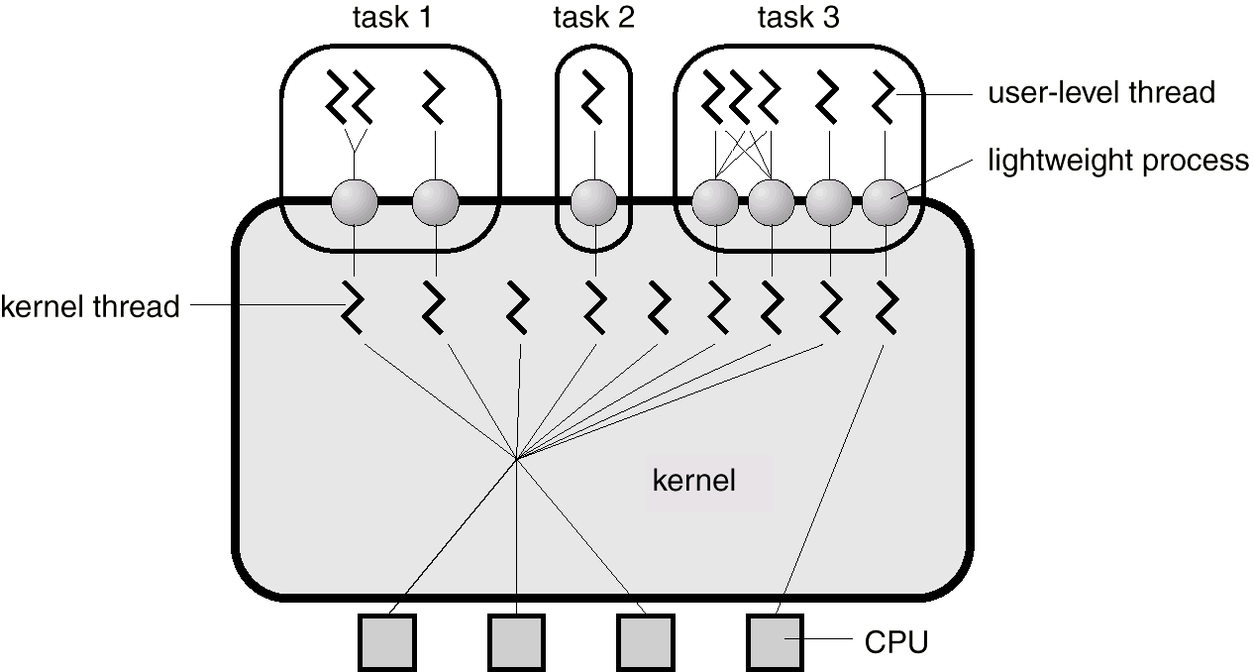
Solaris 2 Threads

Slide 57
Scheduler Activations
Scheduler activations provide upcalls - a communication mechanism from the kernel to the upcall handler in the thread library
This communication allows an application to maintain the correct number kernel threads
NetBSD, FreeBSD
Later abandoned for 1:1 model

Slide 58
One-to-One
Each user-level thread maps to kernel thread
Creating a user-level thread creates a kernel thread
More concurrency than many-to-one
Number of threads per process sometimes restricted due to overhead
Examples
Windows NT/XP/2000
Linux
Solaris 9 and later

Slide 59
Windows Threads
Windows implements the Windows API – primary API for Win 98, Win NT, Win 2000, Win XP, and Win 7
Implements the one-to-one mapping, kernel-level
Each thread contains
A thread id
Register set representing state of processor
Separate user and kernel stacks for when thread runs in user mode or kernel mode
Private data storage area used by run-time libraries and dynamic link libraries (DLLs)

Slide 60
Windows Threads
The register set, stacks, and private storage area are known as the context of the thread
The primary data structures of a thread include:
ETHREAD (executive thread block) – includes pointer to process to which thread belongs and to KTHREAD, in kernel space
KTHREAD (kernel thread block) – scheduling and synchronization info, kernel-mode stack, pointer to TEB, in kernel space
TEB (thread environment block) – thread id, user-mode stack, thread-local storage, in user space

Slide 61
Windows XP Threads Data Structures

Slide 62
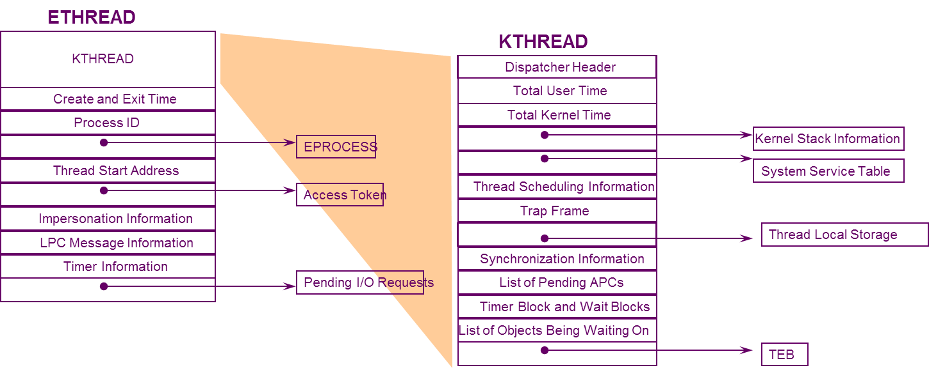
Windows XP Threads Data Structures

Slide 63
End of Chapter 4

Slide 64
Project - Matrix multiplication

Slide 65
Requirements
Chapter 4 Project
Linux OSes
C language, POSIX standard
With appropriate comment!!!
main() function can switch between two modes
Serial computing (s)
Parallel/concurrent computing (p)
Record time eclipsed in each mode
Calculate the serial proportion using Amdahl’s law
By stating how many cores your computer has
Matrix should be large

Slide 66
Hand in
Runnable source code
Class 3 to 220131474@seu.edu.cn (吕希来)
Class 4 to ljtsverkos@gmail.com (刘骏涛)
Laboratory report
To xfliu@seu.edu.cn
Deadline
March 23rd 23:59

